Slide 1
4 Transform-and-Conquer

Slide 2

Transform-and-Conquer
Design methods based on the idea of transformation.
Two-stage procedures:
In the transformation stage,
modify the problem’s instance to be more amenable to solution, for some reasons.
In the conquering stage,
it is solved.

Slide 3
Transform-and-Conquer
Transform-and-conquer strategy:
simpler instance
or
Problems’ another representation solution
instance or
another problem instance
(problem reduction)
transformation stage conquering stage

Slide 4
Transform-and-Conquer
Three major variations by what we transform a given problem’s instance to:
instance simplification - transformation to a simpler instance of the same problem.
representation change – transformation to a different representation of the same instance.
Problem reduction – transformation to an instance of a different problem for which an algorithm is already available.

Slide 5
Transform-and-Conquer
Representation Changes
Examples of the representation change.
Gaussian elimination solves a system of linear equations:
transform it to another system that makes finding a solution easier.
Balanced Search Trees, including AVL trees:
transform an unbalanced binary tree to a binary search tree (also considered to be an instance simplification)
Heaps and heapsort, Horner’s rule and Binary Exponentiation

Slide 6
Transformation and Conquer
Problem Reduction

Slide 7
Transformation and Conquer
Problem Reduction
A transformation and conquer technique (chapter 6)
Examples are
Computing the Least Common Multiple,
Counting paths between two vertices in a graph,
Finding functions’ Maximization and Minimization problems,
Linear Programming (Investment and Knapsack problems).
Reduction to Graph Problems
An important part of P and NP analysis (chapter 11)

Slide 8
Transformation and Conquer – Problem Reduction
Problem Reduction: Definition
To solve an instance of problem A:
Transform the instance of problem A into an instance of problem B
Solve the instance of problem B
Transform the solution to problem B into a solution of problem A
We say that problem A reduces to problem B
Reduction Alg. X
Problem A Problem B solution
(to be solved) (solvable by Alg. X) to Problem B
Figure 6.16. Problem reduction strategy

Slide 9
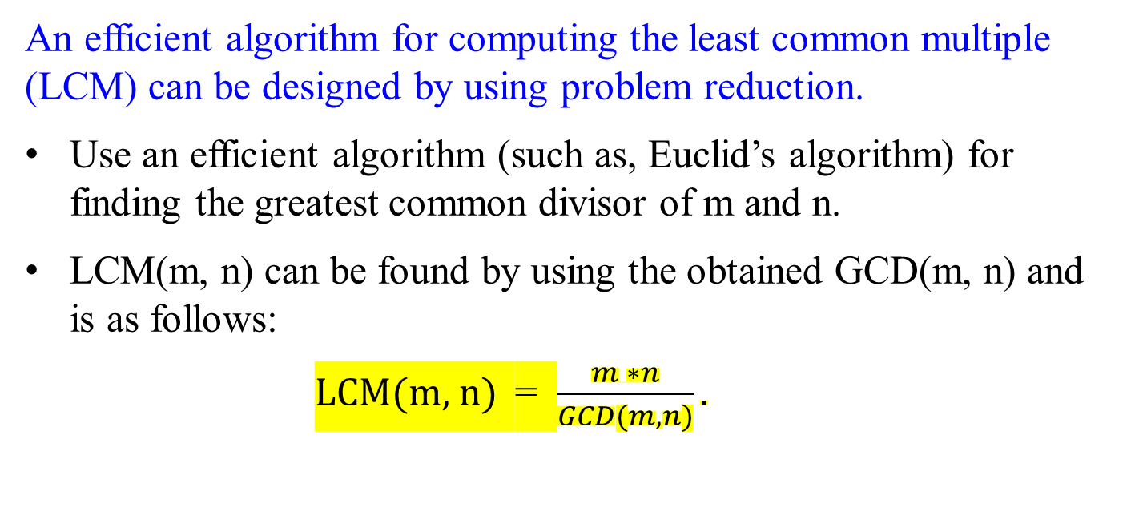
Transformation and Conquer – Problem Reduction
Computing the Least Common Multiple
An efficient algorithm for computing the least common multiple (LCM) can be designed by using problem reduction.
Use an efficient algorithm (such as, Euclid’s algorithm) for finding the greatest common divisor of m and n.
LCM(m, n) can be found by using the obtained GCD(m, n) and is as follows:
LCM(m, n) = $\frac{m ∗n}{GCD(m, n)}.$

Slide 10
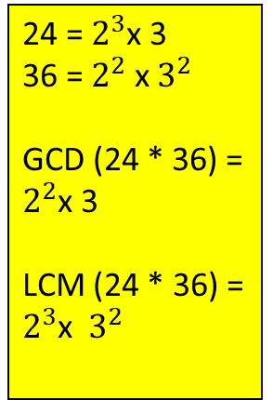
Transformation and Conquer – Problem Reduction
Example 1: Computing the Least Common Multiple
Finding the Least Common Multiple (LCM) of two integers. Example: LCM(24, 36) = 72
Solution technique: reduce LCM to Greatest Common Divisor (GCD):
Instance of Problem A: LCM(24, 36)
Instance of Problem B: GCD(24, 36)
Solution of B: GCD(24, 36) = 12 (by Euclid's algorithm)
Transform the solution of B into a solution of A:
LCM(24, 36) = 24*36 / GCD(24, 36) = 24*36 / 12 = 72
24 = $2^{3}$x 3
36 = $2^{2}$ x $3^{2}$
GCD (24 * 36) = $2^{2}$x 3
LCM (24 * 36) = $2^{3}$x $3^{2}$
Eliminate one set of common elements out and keep the other set in.

Slide 11
Transformation and Conquer – Problem Reduction
Given the prime factorizations of m and n,
LCM(m, n) can be computed as
the product of all the common prime factors of m and n
multiply the product of m’s prime factors that are not in n
multiply n’s prime factors that are not in m.
For example,
24 = 2 * 2 * 2 * 3 2 | 24 36
36 = 2 * 2 * 3 * 3 2 | 12 18
LCM(24, 36) = ( 2 . 2 . 3) * 2 * 3 = 72 3 | 6 9
2 3

Slide 12
Transformation and Conquer – Problem Reduction
Example 2: Solving Element Uniqueness Problem for Two
Dimensional points.
Solve Element Uniqueness problem:
Given a set of two dimensional points, are all elements unique?
Solution technique:
Reduce Element Uniqueness to Closest Pair
Solve Closest Pair
Transform solution of Closest Pair to solution of Uniqueness:
Answer to Element Uniqueness is yes if Closest Pair distance > 0
If there are two closest pairs > 0, then the closest pair distance is not found.

Slide 13
Transformation and Conquer – Problem Reduction
Counting Paths in a Graph
Consider the problem of counting paths between two vertices in a graph.
It can be proved by mathematical induction that
the number of different paths of length k > 0 from the i^{th} vertex to the j^{th} vertex of a graph (undirected or directed)
equal the (i, j)th element of A^{k}, where A is the adjacency matrix of the graph.
Thus the problem of counting a graph’s paths can be solved with
an algorithm for computing an appropriate power of its adjacency matrix.
(In previous discussions, the exponentiation algorithms for computing powers of numbers of applications to matrices.)
A^{n} = A^{n/2} * A^{n/2}
A^{n} = A^{n-1/2} * A^{n-1/2} -1

Slide 14
Counting Paths in a Graph
Consider the problem of counting paths between two vertices in a graph, given in Figure 6.16. There are:
three paths of length 2 that start and end at vertex a: (a, b, a), (a, c, a) and (a, d, a).
Only one path of length 2 from a to c: (a, d, c).
Only one path of length 2 from a to d: (a, c, d).
There is no path of length 2 from a to b.
That is, the path of maximum length is 1 from a to b.
Figure 6.16: (a) A graph.
a
b
c
d

Slide 15
Counting Paths in a Graph
The elements of its adjacency matrix A and its square A² indicate the number of paths of length 1 and 2, respectively between the corresponding vertices of the graph.
a b c d a b c d
a 0 1 1 1 a 3 0 1 1
b 1 0 0 0 b 0 1 1 1
c 1 0 0 1 c 1 1 2 1
d 1 0 1 0 d 1 1 1 2
A =
A² =
a
b
Figure 6.16: A graph, its adjacency
matrix A, and its square A².
c
d

Slide 16
Transformation and Conquer – Problem Reduction
Reduction of Optimization Problems
maximization problem:
A problem to find a maximum of some function.
minimization problem:
A problem to find a function’s minimum.

Slide 17
Reduction of Optimization Problems -
A Minimization Problem.
Suppose you have to find a minimum of some function f(x).
If you know an algorithm for maximizing the function, then you can find the answer from the simple formula:
min f(x) = - max [-f(x)]
To minimize a function,
we can maximize its negative and,
change the sign of the answer, for getting a correct minimal value of the function itself,
This property is illustrated as a function of one real variable in Figure 6.17.

Slide 18
y
y
y
y
f(x)
f(x*)
x
-f(x*)
-f(x)
Figure 6.17: Relationship between minimization and maximization problems: min f(x) = - max[-f(x)]

Slide 19
Likewise, maximization problem:
finding a maximum of some function f(x),
we can minimize the negative, and
change the sign of the answer, for getting a correct maximal value of the function itself.
max f(x) = - min [-f(x)]
This shows how a maximization problem can be reduced to an equivalent minimization problem.

Slide 20
y
f(x)
f(x*)
x
-f(x*)
-f(x)
Figure 6.17: Relationship between minimization and maximization problems: max f(x) = - min[-f(x)]

Slide 21
Minimization and Maximization Problem:
This relationship between minimization and maximization problems is very general:
it holds for functions defined on any domain D.
In particular, we can apply it to functions of several variables subject to additional constraints.
…

Slide 22
Linear Programming
Reduce problems of optimal decision-making to
an instance of a linear programming problem.
A linear programming problem:
a problem of optimizing a linear function of several variables subject to constraints in the form of
linear equations and linear inequalities.

Slide 23
Example 1: Consider a university endowment that needs to invest $100 million.
This sum must be split between three types of investments: stocks, bonds, and cash.
The endowment managers expect an annual return of 10%, 7%, and 3% for their stock, bond, and cash investments, respectively.
Since stocks are riskier than bonds, the endowment rules require
the amount invested in stocks to be no more than one-third of the money invested in bonds.
In addition, at least 25% of the total amount invested in stocks and bonds must be invested in cash.
How should the managers invest the money to maximize the return?

Slide 24
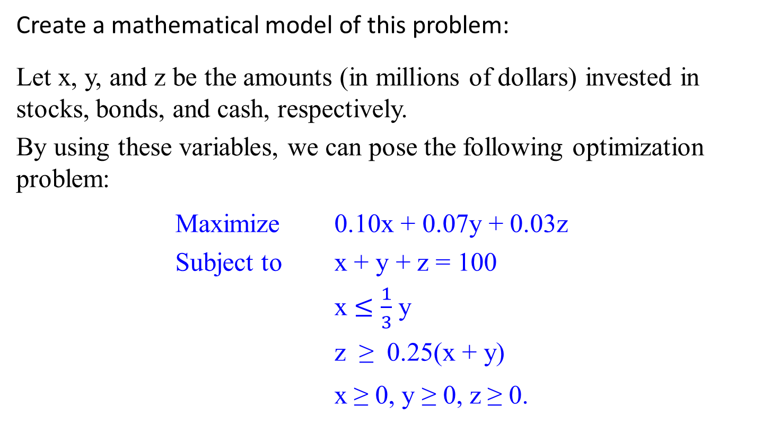
Linear Programming Problem
Create a mathematical model of this problem:
Let x, y, and z be the amounts (in millions of dollars) invested in stocks, bonds, and cash, respectively.
By using these variables, we can pose the following optimization problem:
Maximize 0.10x + 0.07y + 0.03z
Subject to x + y + z = 100
x $≤$ $\frac{1}{3}$ y
z ≥ 0.25(x + y)
x ≥ 0, y ≥ 0, z ≥ 0.

Slide 25
Reduce a problem of optimal decision making to an instance of the general linear programming problem
Maximize c₁ x₁ + c₂ x₂ + … + c_{n} x_{n}
(or minimize)
Subject to a_{i1} x₁ + a_{i2} x₂ + … + a_{in} x_{n} ≤ (or ≥ or = ) b_{i}
for i = 1, 2, …, m.
x₁ ≥ 0, x₂ ≥ 0, …, x_{n} ≥ 0.
The last group of constraints is called the nonnegativity constraints.
Strictly speaking, they are unnecessary
because they are special cases of more general constraints a_{i1} x₁ + a_{i2} x₂ + … + a_{in} x_{n} ≥ b_{i}, but it is convenient to treat them separately.

Slide 26
The classic algorithm for this problem is called the simplex method.
Although the worst-case efficiency of this algorithm is known to be exponential, it performs very well on typical inputs.
Will see more in Iterative Improvement.

Slide 27
Linear programming has proved to be flexible enough to model a wide variety of important applications, such as
airline crew scheduling,
transportation and communication network planning,
oil exploration and refining, and
industrial production optimization.
Linear programming is one of the most important achievements in the history of applied mathematics.

Slide 28
Example 2. How the knapsack problem can be reduced to a linear programming problem.
Given a knapsack of capacity W and
n items of weights w₁, …, w_{n} and
their values v₁, …, v_{n},
find the most valuable subset of the items that fit into the knapsack.

Slide 29
Example 2. knapsack problem:
Consider first the continuous (or fractional) version of the problem, in which any fraction of any item given can be taken into the knapsack.

Slide 30
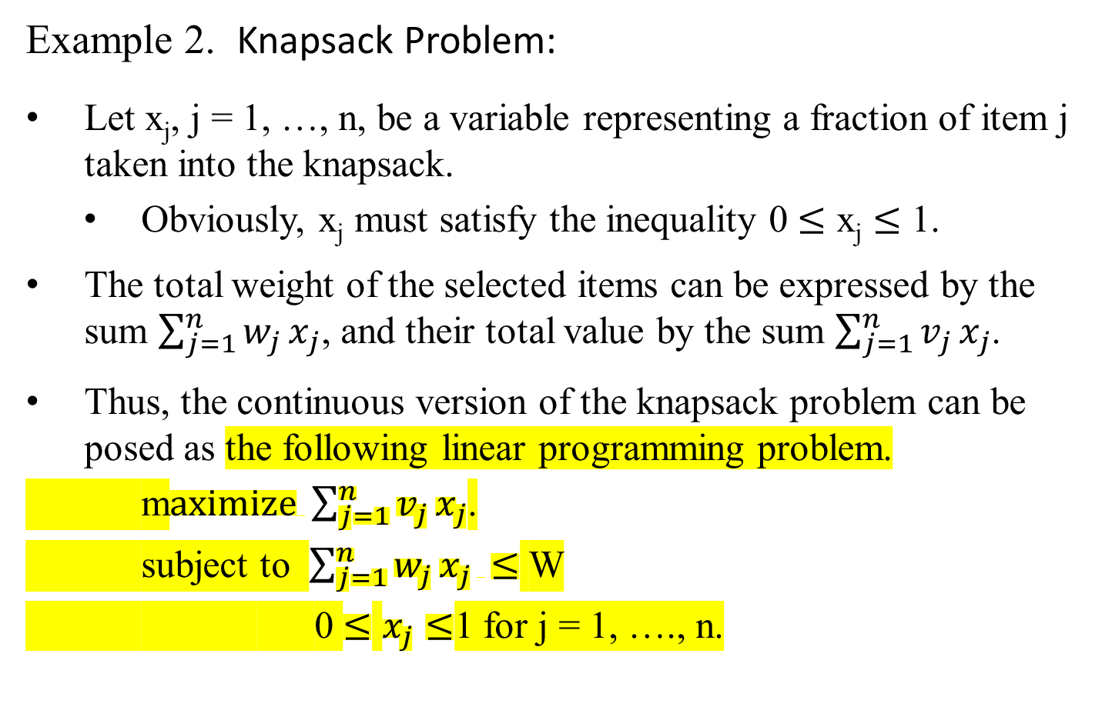
Example 2. Knapsack Problem:
Let x_{j}, j = 1, …, n, be a variable representing a fraction of item j taken into the knapsack.
Obviously, x_{j} must satisfy the inequality 0 $≤$ x_{j} $≤$ 1.
The total weight of the selected items can be expressed by the sum $\sum_{j=1}^{n}{w_{j}}x_{j}$, and their total value by the sum $\sum_{j=1}^{n}{v_{j}}x_{j}$.
Thus, the continuous version of the knapsack problem can be posed as the following linear programming problem.
m$aximize \sum_{j=1}^{n}{v_{j}}x_{j}$.
subject to $\sum_{j=1}^{n}{w_{j}}x_{j} ≤$ W
0 $≤$ $x_{j}≤$1 for j = 1, …., n.

Slide 31
Example 2. Knapsack Problem:
There is no need to apply a general method for solving linear programming problems here:
Solve this particular problem
using a simple special algorithm
introduced in Coping with the Limitations of Algorithm Power
when address the Greedy algorithm for the continuous knapsack problem.
This reduction of the knapsack problem to an instance of the linear programming problem is still useful, though, to prove the correctness of the algorithm in question.

Slide 32
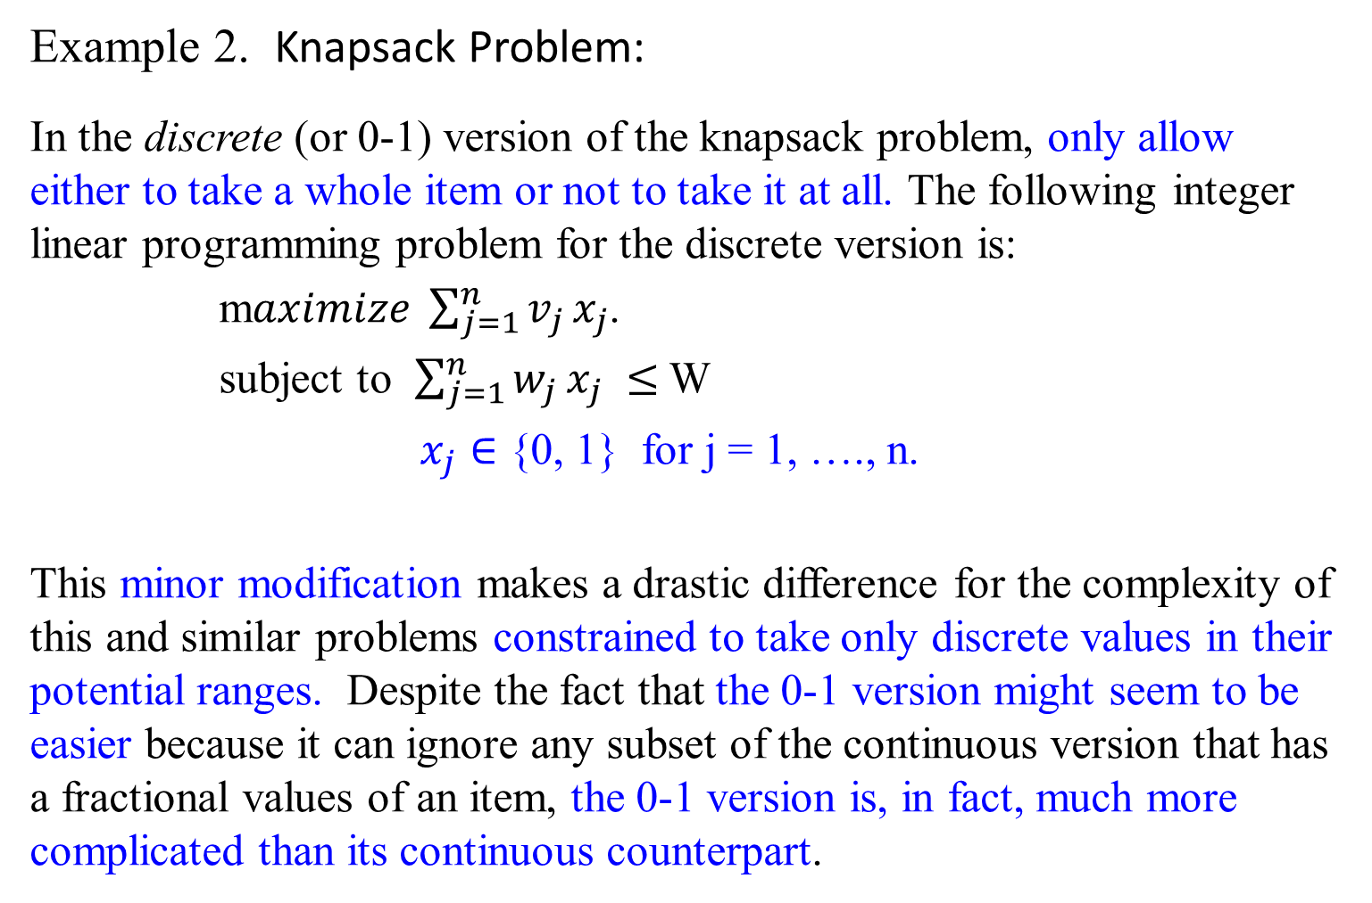
Example 2. Knapsack Problem:
In the discrete (or 0-1) version of the knapsack problem, only allow either to take a whole item or not to take it at all. The following integer linear programming problem for the discrete version is:
m$aximize \sum_{j=1}^{n}{v_{j}}x_{j}$.
subject to $\sum_{j=1}^{n}{w_{j}}x_{j} ≤$ W
$x_{j}∈$ {0, 1} for j = 1, …., n.
This minor modification makes a drastic difference for the complexity of this and similar problems constrained to take only discrete values in their potential ranges. Despite the fact that the 0-1 version might seem to be easier because it can ignore any subset of the continuous version that has a fractional values of an item, the 0-1 version is, in fact, much more complicated than its continuous counterpart.

Slide 34
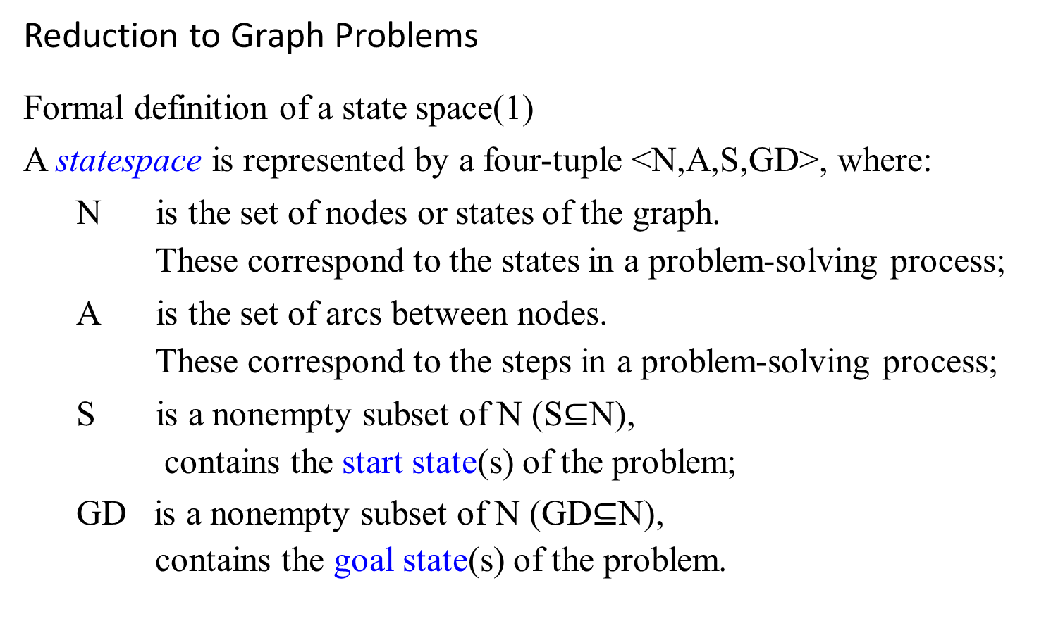
Reduction to Graph Problems
Formal definition of a state space(1)
A statespace is represented by a four-tuple <N,A,S,GD>, where:
N is the set of nodes or states of the graph.
These correspond to the states in a problem-solving process;
A is the set of arcs between nodes.
These correspond to the steps in a problem-solving process;
S is a nonempty subset of N (S$⊆$N),
contains the start state(s) of the problem;
GD is a nonempty subset of N (GD$⊆$N),
contains the goal state(s) of the problem.

Slide 35
Farmer Crosses River Puzzle - Solution
The Puzzle:
A pleasant wants to cross a river and take with him a wolf, a goat, and a cabbage.
There is a boat that can fit himself plus either the wolf, the goat, or the cabbage.
If the wolf and the goat are alone on one shore, the wolf will eat the goat. If the goat and the cabbage are alone on the shore, the goat will eat the cabbage.
How can the farmer bring the wolf, the goat, and the cabbage across the river?

Slide 36
How can the farmer bring the wolf, the goat, and the cabbage across the river?
P, w, g, c stands for the peasant, the wolf, the goat, and the cabbage, respectively.
The two bars || denote the river;
There exist two distinct simple paths from the initial state vertex to the final state vertex
Hence, this puzzle has two solutions, each of which requires seven river crossings.
Use the edges’ label to indicate the boat’s occupants for each crossing. In terms of this graph, find a path from the initial-state vertex, labeled Pwgc||, to the final-state vertex, labeled ||Pwgc.

Slide 37
Pg
Pwgc ||
wc ||Pg
Figure 6.18 State-space graph for the peasant (P), wolf (w), goat (g) and cabbage (c) puzzle to cross the river (||).
P
Pw
Pwc ||g
c ||Pgw
Pc
Pg
Pgc ||w
w ||Pgc
Pc
Pg
Pwg ||c
Pw
g ||Pwc
P
Pg ||wc
Pg
||Pwgc

Slide 38
It is easy to see that
there exist two distinct simple paths from the initial-state vertex to the final state vertex (what are they?),
If we find them by applying breadth-first search, we get a formal proof that these paths have the smallest number of edges possible.
Hence this puzzle has two solutions, each of which requires seven river crossings.
The success in solving this simple puzzle should NOT lead you to believe that generating and investigating state-space graphs is always a straightforward task.

Slide 39
Our Solution:
Farmer takes Goat across (leaving Wolf and Cabbage behind) Farmer returns alone Farmer takes Wolf across Farmer returns with Goat * We now have the Farmer, the Cabbage and the Goat on one side and the Wolf on the other side Farmer takes Cabbage across Farmer returns alone Farmer takes Goat across DONE!

Slide 40
State Space Graph. Let's use 'f', 'c', 'g', 'w' to denote the farmer, the cabbage, the goat, and the wolf, and use '|' to separate the river where left of the '|' denotes west bank and right of the '|' denotes east bank. Initially, they are all at the west bank of the river, which is represented as 'fcgw |' as shown below. We can solve the riddle by figuring out what the possible and valid moves are, using either Breadth-First Search or Depth-First Search, on a state space graph shown below.

Slide 41
Use Breadth First Search to find the first possible solution to the riddle, where it looks like this:
Note: red states are invalid states due to violations of the game rule.

Slide 42
fcgw |
cgw|f
gw|fc
cw|fg
cg|fw
fcw |g
w |fcg
c |fgw
fw|cg
fgw |c
fcg |w
fc|gw
gw|fc
g |fcw
cg|fw
fg |cw
| fcgw

Slide 43
fcgw |
1
cgw|f
gw|fc
cw|fg
cg|fw
2
fcw |g
Simple Depth First Search on State Space Graph
3
w |fcg
c |fgw
4
fw|cg
fgw |c
fcg |w
fc|gw
5
gw|fc
g |fcw
cg|fw
6
fg |cw
7
| fcgw

Slide 44
fcgw |
1
cgw|f
gw|fc
cw|fg
cg|fw
2
fcw |g
Simple Depth First Search with Backtracking on State Space Graph
3
w |fcg
c |fgw
4
7
fw|cg
fgw |c
fcg |w
fc|gw
5
6
gw|fc
g |fcw
cg|fw
8
fg |cw
9
| fcgw

Slide 45
fcgw |
1
cgw|f
gw|fc
cw|fg
cg|fw
2
fcw |g
Breadth First Search on State Space Graph
3
4
w |fcg
c |fgw
5
6
fw|cg
fgw |c
fcg |w
fc|gw
7
8
gw|fc
g |fcw
cg|fw
9
fg |cw
10
| fcgw

Slide 46
Problem Reduction and Performance
If A reduces to B then
If A = Ω(f(n)) then B = Ω(f(n))
In other words, B can have a higher lower bound than A, but not a lower one
For example:
Element Uniqueness is known to be Ω(n lg n).
Therefore, Closest Pair is also Ω(n lg n)

Slide 47
Problem Reduction and Performance
…
More detail on Closest Pair:
Closest Pair = Ω(n lg n) is still true if Closest Pair's lowest bound is actually higher (eg Ω(n^2))
But the lower bound for Closest Pair can not be lower (eg it can't be Ω(n))
Actually, the lower bound for Closest Pair can be proved using decision trees, to be Ω(n lg n), which is also the upper and tight bound.
Truth in advertising: Some fine points about the performance of the reduction should be considered

Slide 48
Careful!
This is NOT CORRECT:
If A reduces to B and B=Ω(f(n)), then A=Ω(f(n))
Remember
Remember this: If A reduces to B, then the lower bound for B can't be less than the lower bound for A
B's lower bound can be higher, but not lower.

Slide 49

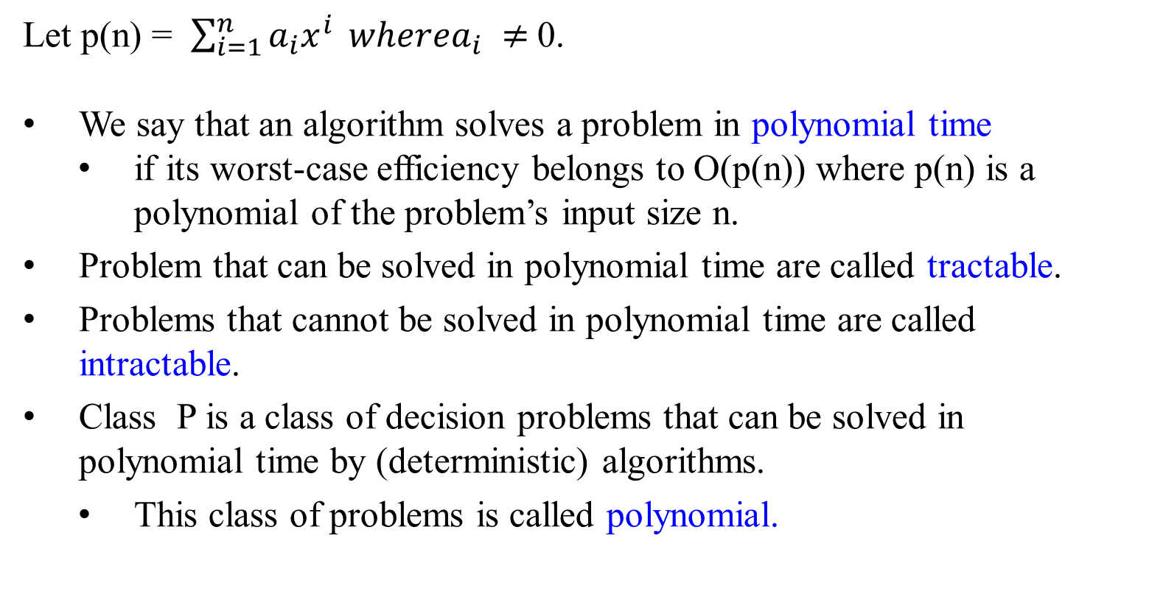
Let p(n) = $\sum_{i=1}^{n}{a_{i}x^{i}} wherea_{i}$ $≠$0.
We say that an algorithm solves a problem in polynomial time
if its worst-case efficiency belongs to O(p(n)) where p(n) is a polynomial of the problem’s input size n.
Problem that can be solved in polynomial time are called tractable.
Problems that cannot be solved in polynomial time are called intractable.
Class P is a class of decision problems that can be solved in polynomial time by (deterministic) algorithms.
This class of problems is called polynomial.

Slide 50
A nondeterministic algorithm is a two-stage procedure that takes as its input an instance I of a decision problem and does the following:
Nondeterministic (“guessing”) stage:
Generate an arbitrary string S as
a candidate solution to the given instance I
(but may be complete gibberish as well).
Deterministic (“verification”) stage:
A determine algorithm take both I and S as its input and
outputs yes if S represents a solution to instance I.
(If S is not a solution to instance I, the algorithm either returns no or is allowed not to halt at all).
A nondeterministic algorithm is said to be nondeterministic polynomial (NP) if the time efficiency of its verification stage is polynomial.

Slide 51
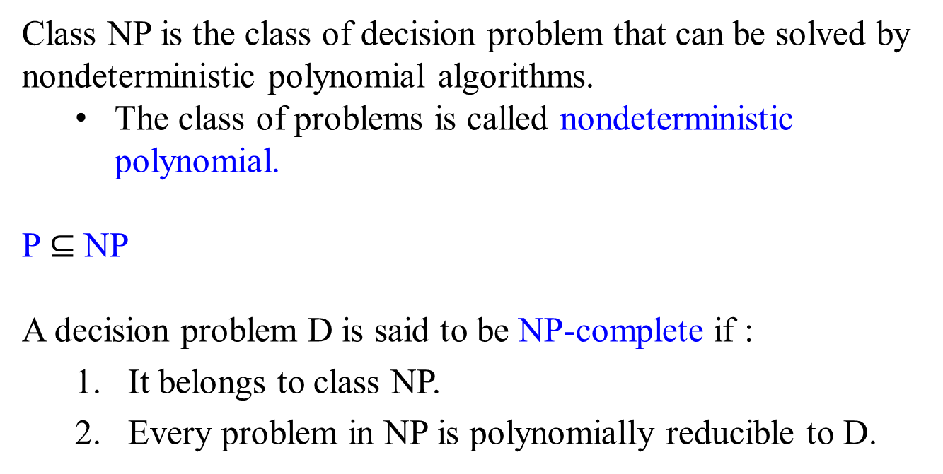
Class NP is the class of decision problem that can be solved by nondeterministic polynomial algorithms.
The class of problems is called nondeterministic polynomial.
P $⊆$ NP
A decision problem D is said to be NP-complete if :
It belongs to class NP.
Every problem in NP is polynomially reducible to D.

Slide 52
Solving Complexity Problem
To show that a decision problem P is undecidable
must find a reduction from a decision problem which is already known to be undecidable to P.
That reduction function must be a computable function.
In particular, we often show that a problem P is undecidable by showing that the halting problem reduces to P.
The complexity classes P, NP, PSPACE are closed under (many-one, "Karp") polynomial-time reductions.
The complexity classes L, NL, P, NP and PSPACE are closed under log-space reduction.

Slide 53
The End

